Slide 1

Customer Segmentation in Banking
Presented by : Akanksha Sharma

Slide 2
Project Overview
The project aims to develop an interactive customer segmentation dashboard for an imaginary bank operating in UK using Tableau.
This dashboard will visually represent the distribution of customers across different regions of the United Kingdom.
It will analyze customer distribution based on balance bands, age groups, gender, and job classification, providing valuable insights for targeted marketing and strategic decision-making.

Slide 3
Key Metrics
Here are some key metrics for your customer segmentation dashboard project:
Customer Distribution by Region: Number of customers in each region of the United Kingdom.
Balance Bands: Distribution of customers across different balance bands.
Age Groups: Number of customers in each age group.
Gender Distribution: Percentage of male and female customers.
Job Classification: Distribution of customers by job classification.
Customer Demographics: Breakdown of customer demographics in each region (e.g., age, gender, job classification).
Customer Insights: Key insights derived from the analysis, such as predominant customer profiles in each region.

Slide 4
Actionable Insights
England is mostly represented by white-collar workers (70%).
Customers in Scotland are predominantly males in their late 40s and early 50s, with a low representation of white-collar workers.
Data for Wales shows an above-average representation of mid-sized balances.
Northern Ireland is mostly represented by female customers in younger age groups

Slide 5
Challenges Faced
Assigning Geographical Roles to fields to create map.
Performing Table Calculations and creating calculated Fields
Creating Bins
Creating Parameters
Using Annotations to call out to specific marks, points or area vizualisation.
Visualizing the data using filled maps, Pie charts, Treemap.
Creating interactive dashboards and storyline

Slide 6
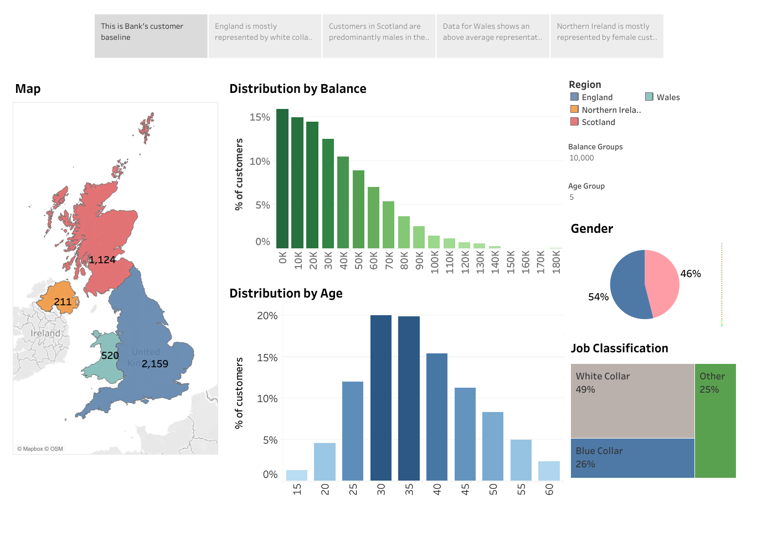
Conclusion
This dashboard represents the bank's customer baseline, offering a comprehensive view of customer demographics and financial profiles across the UK.

